Slide 1
Bypassing Worst Case Analysis:
Tensor Decomposition and Clustering
Moses Charikar
Stanford University

Slide 2
Rich theory of analysis of algorithms and complexity founded on worst case analysis
Too pessimistic
Gap between theory and practice

Slide 3
Bypassing worst case analysis
Average case analysis
  unrealistic?
Smoothed analysis [Spielman, Teng ‘04]
Semi-random models
  instances come from random + adversarial process
Structure in instances
  Parametrized complexity, Assumptions on input
“Beyond Worst Case Analysis”
course by Tim Roughgarden

Slide 4
Two stories
Convex relaxations for optimization problems
Tensor Decomposition
Talk plan:
Flavor of questions and results
No proofs (or theorems)

Slide 5
Part 1:
Integrality of COnvex relaxations

Slide 6
Relax and Round paradigm
Optimization over feasible set hard
Relax feasible set to bigger region
optimum over relaxation easy
  fractional solution
Round fractional optimum
  map to solution in feasible set

Slide 7
Can relaxations be integral?
Happens in many interesting cases
  All instances (all vertex solutions integral)
  e.g. Matching
  Instances with certain structure
  e.g. “stable” instances of Max Cut
  [Makarychev, Makarychev, Vijayaraghavan ‘14]
  Random distribution over instances
Why study convex relaxations:
  not tailored to assumptions on input
  proof of optimality

Slide 8
Integrality of convex relaxations
LP decoding
  decoding LDPC codes via linear programming
  [Feldman, Wainwright, Karger ‘05] + several followups
Compressed Sensing
  sparse signal recovery
  [Candes, Romberg, Tao ‘04] [Donoho ‘04] + many others
Matrix Completion
  [Recht, Fazel, Parrilo ‘07] [Candes, Recht ‘08]
  [Candes, Tao ‘10] [Recht ‘11] + more

Slide 9
MAP inference via Linear Programming
[Komodakis, Paragios ‘08] [Sontag thesis ’10]
Maximum A Posteriori inference in graphical models
  side chain prediction, protein design, stereo vision
various LP relaxations
  pairwise relaxation: integral 88% of the time
  pairwise relaxation + cycle inequalities: 100% integral
[Rush, Sontag, Collins, Jaakkola ‘10]
  Natural Language Processing (parsing, part-of-speech tagging)
  “Empirically, the LP relaxation often leads to an exact solution to the original problem.”

Slide 10
(Semi)-random graph partitioning
“planted” graph bisection
p: prob. of edges inside
q: prob. of edges across parts
Goal: recover partition
SDP relaxation is exact [Feige, Kilian ’01]
robust to adversarial additions inside/deletions across
(also [Makarychev, Makarychev, Vijayaraghavan ‘12,’14])
Threshold for exact recovery [Mossel, Neeman, Sly ‘14]
[Abbe, Bandeira, Hall ’14] via SDP
q
p
p

Slide 11
Thesis
Integrality of convex relaxations is interesting phenomenon that we should understand
Different measure of strength of relaxation
Going beyond “random instances with independent entries”

Slide 12
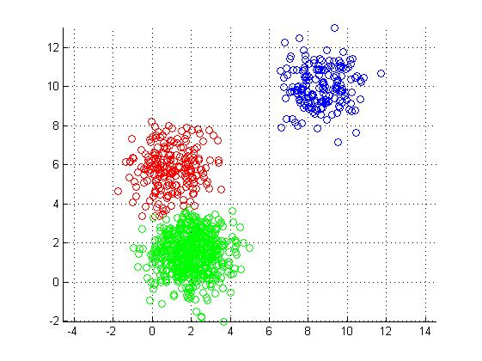
(Geometric) Clustering
Given points in , divide into k clusters
Key difference: distance matrix entries not independent!
[Elhamifar, Sapiro,
Vidal ‘12]
integer solutions from
convex relaxation

Slide 13
Distribution on inputs
[Nellore, Ward ‘14]
n points drawn randomly from each of k spheres
(radius 1)
Minimum separation Δ between centers
How much separation to guarantee integrality?
[Awasthi, Bandeira, C, Krishnaswamy, Villar, Ward ’14]
Δ
Notes:
Δ

Slide 14
Lloyd’s method can fail
Multiple copies of 3 cluster configuration:
Lloyd’s algorithm fails if initialization either
  assigns some group < 3 centers, or
  assigns some group 2 centers in C_{i} and one in A_{i} B_{i}
Random initialization (also k-means++) fails w.h.p.
A_{i}
C_{i}
B_{i}

Slide 15
k-median
Given: point set, metric on points
Goal: Find k centers, assign points to closest center
Minimize: sum of distances of points to centers

Slide 16
k-median LP relaxation
z_{pq}: q assigned to center at p
y_{p}: center at p
every q assigned to one center
q assigned to p ➔ center at p
exactly k centers
well studied relaxation in
Operations Research and
Theoretical Computer Science
Notes:
\min \mbox{\ \ } \sum_{p,q} d(p,q) z_{pq}
\mbox{s.t. \ \ } \sum_{p \in P} z_{pq} = 1 \mbox{\ \ \ } \forall q \in P
z_{pq} \leq y_p \mbox{\ \ \ } \forall p,q \in P
\sum_{p \in P} y_p = k
z_{pq} \geq 0 \mbox{\ \ \ } \forall p,q \in P
y_{p} \geq 0 \mbox{\ \ \ } \forall p \in P

Slide 17
k-means
Given: point set in
Goal: Partition into k clusters
Minimize: sum of squared distances to cluster centroids
Equivalent objective:
Notes:
\Re^d
\sum_{i=1}^k \frac{\sum_{p,q \in C_i} d^2(p,q)}{|C_i|}

Slide 18
k-means LP relaxation
objective:
0
0
Notes:
\sum_{i=1}^k \frac{\sum_{p,q \in C_i} d^2(p,q)}{|C_i|}
\sum_{p,q} d^2(p,q) z_{pq}

Slide 19
k-means LP relaxation
z_{pq} > 0: p and q in cluster of size 1/z_{pq}
y_{p} > 0: p in a cluster of size 1/y_{p}
exactly k clusters
Notes:
\min \mbox{\ \ } \sum_{p,q} d^2(p,q) z_{pq}
\mbox{s.t. \ \ } \sum_{p \in P} z_{pq} = 1 \mbox{\ \ \ } \forall q \in P
z_{pq} \leq y_p \mbox{\ \ \ } \forall p,q \in P
z_{pq} \leq y_q \mbox{\ \ \ } \forall p,q \in P
\sum_{p \in P} y_p = k
z_{pq} \geq 0 \mbox{\ \ \ } \forall p,q \in P
y_{p} \geq 0 \mbox{\ \ \ } \forall p \in P

Slide 20
k-means SDP relaxation
[Peng, Wei, ‘07]
z_{pq} > 0: p and q in cluster of size 1/z_{pq}
z_{pp} = y_{p} > 0: p in a cluster of size 1/y_{p}
exactly k clusters
0
“integer” Z =
0
Notes:
\min \mbox{\ \ } \mathbf{Tr}(DZ)
\mbox{s.t. \ \ } \mathbf{Tr}(Z) = k
Z \mathbf{1} = \mathbf{1}
Z \geq 0
Z \succeq 0

Slide 21
Results
k-median LP is integral for Δ ≥ 2+ε
  Jain-Vazirani primal-dual algorithm recovers optimal solution
k-means LP is integral for Δ > 2+√2
(not integral for Δ < 2+√2)
k-means SDP is integral for Δ ≥ 2+ ε (d large)
[Iguchi, Mixon, Peterson, Villar ‘15]
Notes:
\mathbf{\sqrt{\frac{2k}{d}}}

Slide 22
Proof Strategy
Exhibit dual certificate
  lower bound on value of relaxation
  addnl properties: optimal solution of relaxation is unique
“Guess” values of dual variables
Deterministic condition for validity of dual
Show condition holds for input distribution

Slide 23
Failure of k-means LP
If there exist p in C₁, q in C₂
then k-means LP can “cheat”
p
q
Notes:
d(p,q) < \mathbf{E}_{r \in C_1}[d(p,r)]
d(p,q) < \mathbf{E}_{r \in C_2}[d(q,r)]

Slide 24
Rank recovery
Distribution on inputs with noise
low noise
medium noise
high noise
exact recovery of optimal solution
planted solution not optimal, yet convex relaxation recovers low rank solution
convex relaxation not integral; exact optimization hard?
Rank Recovery

Slide 25
Multireference Alignment
[Bandeira, C, Singer, Zhu ‘14]
signal
random rotation
add noise

Slide 26
Multireference alignment
Many independent copies of process: X₁, X₂, …, X_{n}
Recover original signal (upto rotation)
If we knew rotations, unrotate and average
SDP with indicator vectors for every X_{i} and possible rotations 0,1,…,d-1
<v_{i,r(i)} , v_{j,r(j)}> : “probability” that we pick
rotation r(i) for X_{i} and rotation r(j) for X_{j}
SDP objective: maximize sum of dot products of “unrotated” signals

Slide 27
Rank recovery
Challenge: how to construct dual certificate?
low noise
medium noise
high noise
exact recovery of optimal solution
planted solution not optimal, yet convex relaxation recovers low rank solution
convex relaxation not integral; exact optimization hard?
Rank Recovery

Slide 28
Questions / directions
More general input distributions for clustering?
Really understand why convex relaxations are integral
  dual certificate proofs give little intuition
Integrality of convex relaxations in other settings?
Explain rank recovery
Exact recovery via convex relaxation + postprocessing?
[Makarychev, Makarychev, Vijayaraghavan ‘15]
When do heuristics succeed?

Slide 29
Part 2: Tensor Decomposition
with Aditya Bhaskara, Ankur Moitra, Aravindan Vijayaraghavan

Slide 30
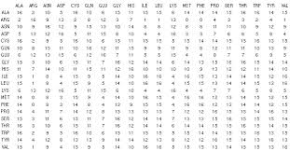


Factor analysis
movies
test scores
people
people
Believe: matrix has a “simple explanation”
(sum of “few” rank-one factors)
+
+
Notes:
(a_1 + a_2) \otimes (b_1 + b_2) + (a_1 - a_2) \otimes (b_1-b_2) = 2 (a_1 \otimes b_1 + a_2 \otimes b_2)

Slide 31
Factor analysis
movies
test scores
people
people
Believe: matrix has a “simple explanation”
Sum of “few” rank one matrices (R < n )
Many decompositions – find a “meaningful” one (e.g. non-negative, sparse, …) [Spearman 1904]
Notes:
(a_1 + a_2) \otimes (b_1 + b_2) + (a_1 - a_2) \otimes (b_1-b_2) = 2 (a_1 \otimes b_1 + a_2 \otimes b_2)

Slide 32
The rotation problem
Any suitable “rotation” of the vectors gives a different decomposition
A
A
B^{T}
=
Q
Q⁻¹
B^{T}
Often difficult to find “desired” decomposition..
Notes:
(a_1 + a_2) \otimes (b_1 + b_2) + (a_1 - a_2) \otimes (b_1-b_2) = 2 (a_1 \otimes b_1 + a_2 \otimes b_2)

Slide 33
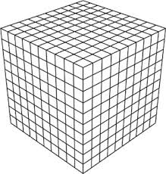
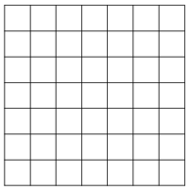
Tensors
Multi-dimensional arrays
n
n
n
n
n
Represent higher order correlations, partial derivatives, etc.
Collection of matrix (or smaller tensor) slices

Slide 34
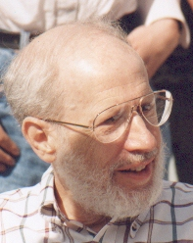
3-way factor analysis
n
Tensor can be written as a sum of few rank-one tensors
Smallest such R is called the rank
n
n
[Kruskal 77]. Under certain rank conditions, tensor decomposition is unique!
surprising! 3-way decompositions overcome the rotation problem
Notes:
T = a_1 \otimes b_1 \otimes c_1 + \dots + a_R \otimes b_R \otimes c_R

Slide 35
Applications
Psychometrics, chemometrics, algebraic statistics, …
Identifiability of parameters in latent variable models
[Allman, Matias, Rhodes 08]
[Anandkumar, et al 10-]
Recipe:
Compute tensor whose decomposition encodes parameters
  (multi-view, topic models, HMMs, ..)
Appeal to uniqueness (show that conditions hold)

Slide 36
Kruskal rank & uniqueness
…
A =
, B = … , C = … (n x R)
stronger notion than rank
reminiscent of restricted isometry
(Kruskal rank). The largest k for which every k-subset of columns (of A) is linearly independent; denoted KR(A)
[Kruskal 77]. Decomposition [A B C] is unique if it satisfies:
KR(A) + KR(B) + KR(C) ≥ 2R+2

Slide 37

Learning via tensor decomposition
Recipe:
Compute tensor whose decomposition encodes parameters
  (multi-view, topic models, HMMs, ..)
Appeal to uniqueness (show that conditions hold)
Cannot estimate tensor exactly (finite samples)
Models are not exact!

Slide 38
Result I (informal)
[Bhaskara, C, Vijayaraghavan ‘14]
A robust uniqueness theorem
[Kruskal 77]. Given T = [A B C], can recover A,B,C if:
KR(A) + KR(B) + KR(C) ≥ 2R+2
(Robust). Given T = [A B C] + err, can recover A,B,C (up to err’ ) if:
KR_{τ}(A) + KR_{τ}(B) + KR_{τ}(C) ≥ 2R+2
Err and Err’ are polynomially related (poly(n, τ))
KR_{τ}(A) robust analog of KR(.) – require every (nxk)-submatrix to have condition number < τ
Implies identifiability with polynomially many samples!

Slide 39

Identifibility vs. algorithms
(Robust). Given T = [A B C] + err, can recover A,B,C (up to err’ ) if:
KR_{τ}(A) + KR_{τ}(B) + KR_{τ}(C) ≥ 2R+2
both Kruskal’s theorem and our results “non-constructive”
Algorithms known only for full rank case: two of A,B,C have rank R
[Jennrich][Harshman 72][Leurgans et al. 93][Anandkumar et al. 12]
General tensor decomposition, finding tensor rank, etc. all NP hard
  [Hastad 88][Hillar Lim 08]
Open problem: can Kruskal’s theorem be made algorithmic?

Slide 40
Algorithms FOR
TENSOR DECOMPOSITION

Slide 41
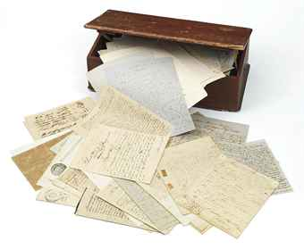
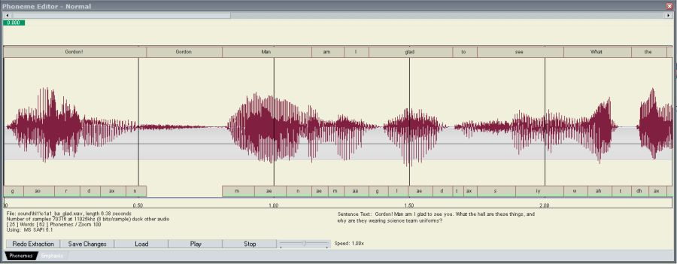
Generative models for data
Assumption. given data can be “explained” by a probabilistic generative model with few parameters
(samples from data ~ samples generated from model)
Learning Qn: given many samples from model, find parameters

Slide 42
Gaussian mixtures (points)
Parameters:
R gaussians (means)
mixing weights (sum 1) w₁, …, w_{R}
To generate a point:
pick a gaussian (w.p. w_{r})
sample from
Notes:
\sum_{i=1}^R w_i (\mu_i \otimes \mu_i \otimes \mu_i)

Slide 43
Topic models (docs)
Idea: every doc is about a topic, and each topic is a prob. distribution over words (R topics, n words)
Parameters:
R probability vectors p_{r}
mixing weights w₁, …, w_{R}
To generate a doc:
pick topic Pr[ topic r ] = w_{r}
pick words: Pr[ word j ] = p_{r}(j)
Notes:
\sum_{r=1}^R w_r p_r(i) p_r(j)
(10 min)

Slide 44

Recipe for estimating parameters
step 1. compute a tensor whose decomposition encodes model parameters
step 2. find decomposition (and hence parameters)
[Allman, Matias, Rhodes]
[Rhodes, Sullivan] [Chang]
“Identifiability”
Notes:
\sum_{r=1}^R w_r (p_r \otimes p_r \otimes p_r)

Slide 45
Illustration
Gaussian mixtures:
  Can estimate the tensor:
  Entry (i,j,k) is obtained from
Topic models:
  Can estimate the tensor:
Moral: algorithm to decompose tensors => can recover parameters in mixture models
Notes:
\sum_{i=1}^R w_i (\mu_i \otimes \mu_i \otimes \mu_i)
\sum_{r=1}^R w_r (p_r \otimes p_r \otimes p_r)

Slide 46
Tensor linear algebra is hard
with power comes intractability
[Hastad ‘90] [Hillar, Lim ‘13]
Hardness results are worst case
What can we say about typical instances?
Gaussian mixtures:
Topic models:
Smoothed analysis [Spielman, Teng ‘04]

Slide 47
Smoothed model
Typical Instances
Component vectors perturbed:
Input is tensor product of perturbed vectors
[Anderson, Belkin, Goyal, Rademacher, Voss ‘14]

Slide 48
One easy case..
[Harshman 1972] [Jennrich] Decomposition is easy when the vectors involved are (component wise) linearly independent
[Leurgans, Ross, Abel 93]
[Chang 96]
[Anandkumar, Hsu, Kakade 11]
If A,B,C are full rank, then can recover them, given T
If A,B,C are well conditioned, can recover given T+(noise)
      [Stewart, Sun 90]
…
A =
(unfortunately) holds in many applns..
No hope in the “overcomplete” case (R >> n) (hard instances)

Slide 49
Basic idea
Consider a 6th order tensor with rank R < n²
Trick: view T as an n² x n² x n² object
vectors in the decomposition are:
Question: are these vectors linearly independent?
plausible.. vectors are n² dimensional ☺
Notes:
\{ a_r \otimes b_r \}_{i=1}^R

Slide 50
Product vectors & linear structure
Q: is the following matrix well conditioned? (allows robust recovery)
Vectors in n² dim space, but “determined” by vectors in n space
Inherent “block structure”
Theorem (informal). For any set of vectors {a_{r}, b_{r}}, a perturbation is “good” (for R < n²/4), with probability 1- exp(-n*).
can be generalized to higher order products.. (implies main thm)
smoothed analysis
Notes:
\sum_{i=1}^R w_i ~(\mu_i \otimes \mu_i \otimes \mu_i \otimes \mu_i \otimes \mu_i \otimes \mu_i )

Slide 51
Proof sketch
Lemma. For any set of vectors {a_{i}, b_{i}}, matrix below (for R < n²/4) has condition number < poly(n/ρ), with probability 1- exp(-n*).
Issue: perturb before product.. easy if we had perturbed columns of this matrix
usual results on random matrices don’t apply
Technical contribution: product of perturbed vectors behave like random vectors in
Notes:
a_i \rightarrow \widetilde{a_i}
\widetilde{a_i} = a_i + \varepsilon_i

Slide 52
Proof Strategy
Every has large projection
onto space orthogonal to span of the rest
Problem: Don’t know orthogonal space
Instead: Show that has large projection onto any 3n²/4 dimensional space

Slide 53
Result
[Bhaskara, C, Moitra, Vijayaraghavan ‘14]
Theorem (informal). For higher order(d) tensors, we can typically compute decompositions for much higher rank ( )
smoothed analysis
Definition. Call parameters robustly recoverable if we can recover them (up to ε.poly(n)) given T+(noise), where (noise) is < ε, and
most parameter settings are robustly recoverable
Theorem. For any , and , perturbations are robustly recoverable w.p. 1-exp(-n^{f(d)}).
Notes:
R \le n^{\lceil (d-1)/2 \rceil}
T = \sum_{r=1}^R \tilde{a}_r^{(1)} \otimes \tilde{a}_r^{(2)} \otimes \cdots \otimes \tilde{a}_r^{(d)}

Slide 54
Our result for mixture models
Corollary. Given samples from a mixture model (topic model, Gaussian mixture, HMM, ..), we can “almost always” find the model parameters in poly time, for any R < poly(n).
observation: we can usually estimate necessary higher order moments
[Anderson, Belkin, Goyal, Rademacher, Voss ‘14]
sample complexity: poly_{d}(n,1/ρ)
error probability: poly(1/n)
Here:
poly_{d}(n,1/ρ)
exp(-n^{1/3^{d}})

Slide 55
Questions, directions
Algorithms for rank > n for 3-tensors?
  can we decompose under Kruskal’s conditions?
  plausible ways to prove hardness?
  [Anandkumar, Ge, Janzamin ‘14] (possible for O(n) incoherence)
Dependence on error
  do methods completely fail if error is say constant?
  new promise: SoS semidefinite programming approaches
  [Barak, Kelner, Steurer ‘14]
  [Ge, Ma ‘15] [Hopkins, Schramm, Shi, Steurer ‘15]

Slide 56

Questions?

